Slide 1
Vehicle Parts Management System
Teammates: L. Keerthana -2010030512 M. Manideepa -2010030517 A. Sai Pranay -2010030467 C. Sathwik -2010030468

Slide 2
Table OF Context
Introduction
Literature Survey
Flow Chart
GitHub Setup
Project Testing
Conclusion

Slide 3
INTRODUCTION
Vehicle Management System web application is widely used by managers to store, retrieve and modify their customers' information. This project is the implementation of a backend web application where we can create, read, update and delete (CRUD) customer information. This exciting CRUD application will be built using JSP, HTML, MYSQL WORKBENCH, CSS and MySQL (for managing RDBMS).

Slide 4
LITERATURE REVIEW
- A New Consumer Relationship Model: The Marketing Communications Application
Published online: 29 Oct 2018
Authors: Alkis Thrassou and Demetris Vrontis
The article investigates empowered consumer behavior and explores its evolutionary nature and contemporary contexts in developed countries. Through a comprehensive literature review multi-perspective analysis, it finally develops a prescriptive marketing communication model in the context of an evolving business-consumer relationship and its corresponding marketing philosophy. The findings identify a rising symbiotic equilibrium between consumers’ power and businesses’ influence on consumers’ perceptions. Consumer “needs” are found to be increasingly manifested into “wants” which are intangible, of obscure value, affective in nature and vulnerable to marketing communications; the latter being increasingly oriented towards “perception management” and with “branding” as a primary vehicle.

Slide 5
Application of data mining techniques in customer relationship management: A literature review and classification
Published Date:March 2020
Authors:Marina Sakolova and Antonio Fernandez Cabllero
This paper presents an approach to the creation of an agent-based system for the assessment of environmental impact upon human health. As indicators of the environmental impact water pollution, indexes of traffic and industrial activity, wastes and solar radiation are assumed. And as human health indicator morbidity is taken. All the data comprise multiple heterogeneous data repositories. The system is logically and functionally divided into three layers, solving the tasks of information fusion, pattern discovery and decision support making, respectively. The outcomes of the system design phase under Prometheus methodology and the complete characteristics of the agents forming the proposal are discussed. The discovered patterns are used as a foundation for real-time decision making, which is of great importance for adequate and effective management by responsible governmental authorities.

Slide 6
Documentation (Implementation flow chart)
Creating project in IDE
Testing whether data is storing in MYSQL or not.
Performing tests such as:
classes of valid input must be accepted.
All field entries must work properly
03
Creating required jsp, html, css files
Checking created files are running on server
02
Establishing connection with MYSQL
Creating modules(customer ,seller)

Slide 7
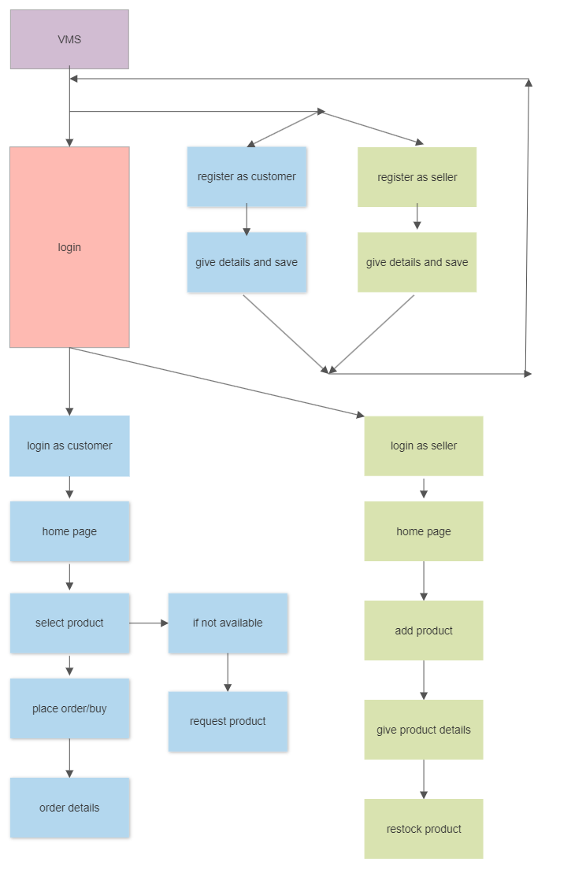
Flow Chart

Slide 8
ADVANTAGES
1. Better customer service 2. Increased sales 3. Higher productivity and efficiency 4. Centralized database of information 5. More accurate sales forecasting 6. Streamlined internal communications

Slide 9
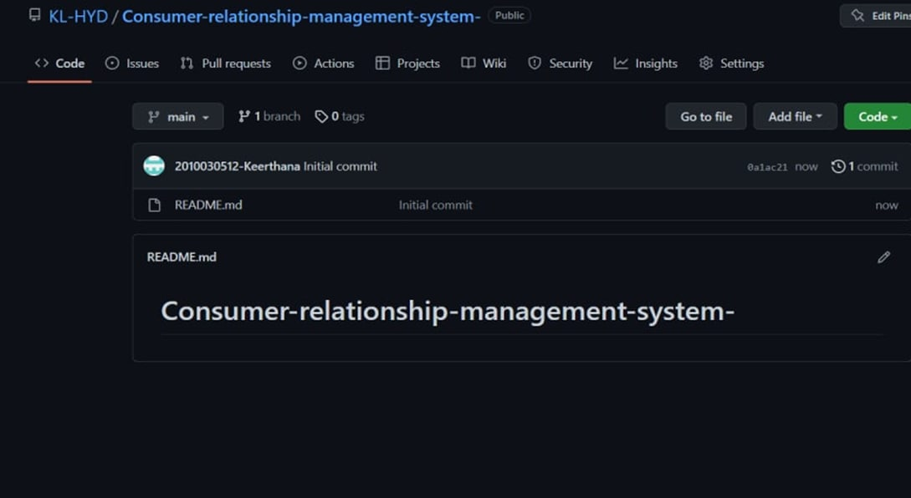
GITHUB SETUP

Slide 10
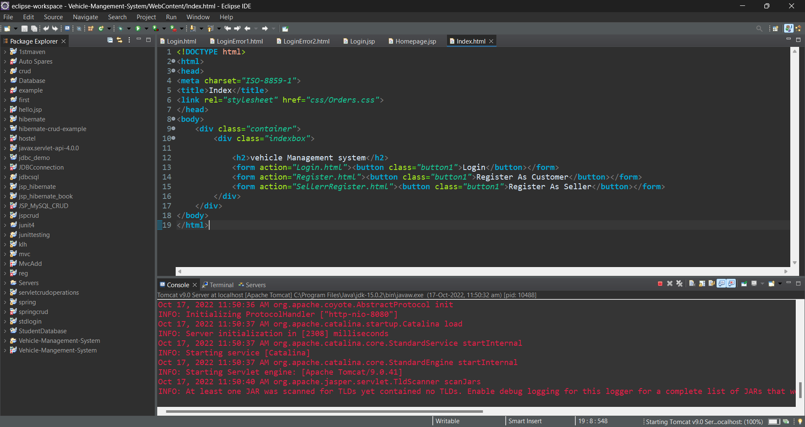
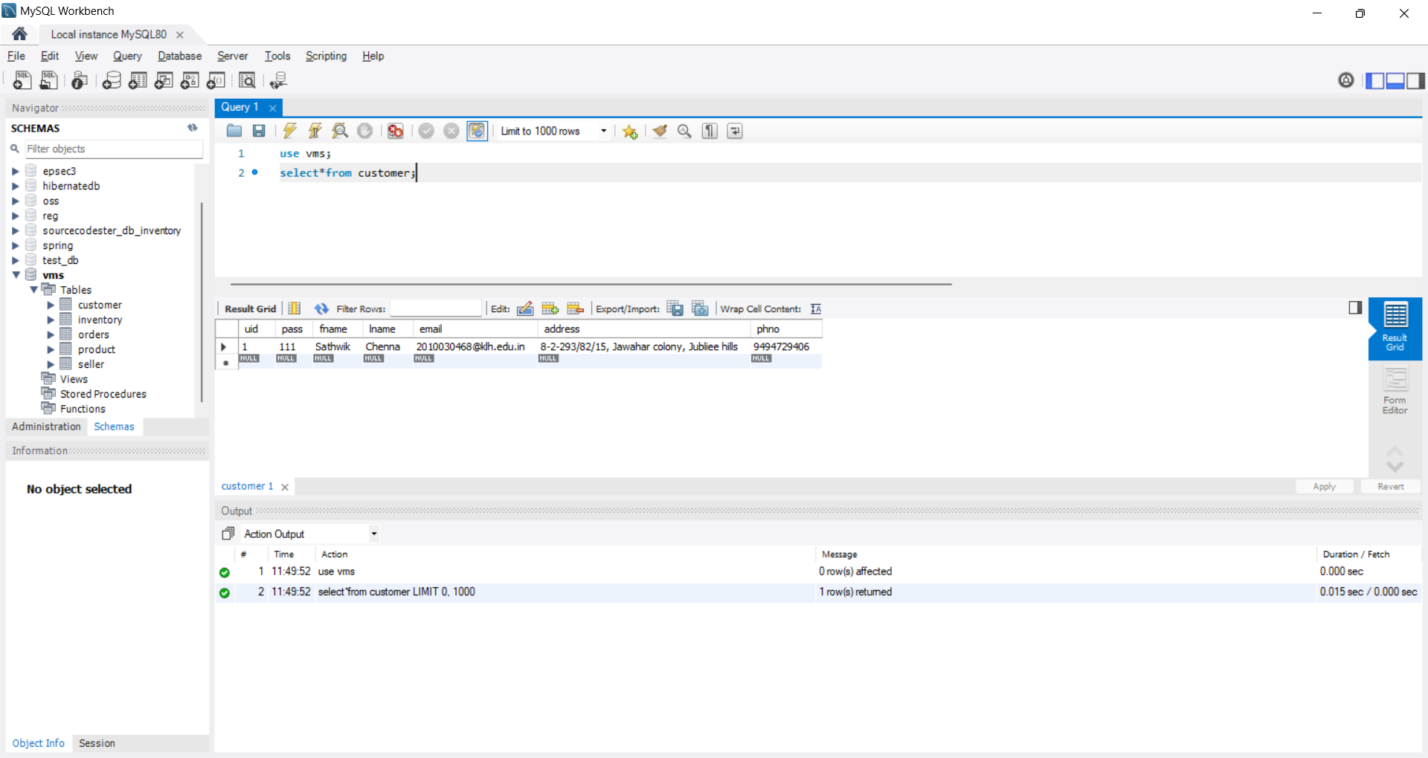
Project Testing

Slide 11
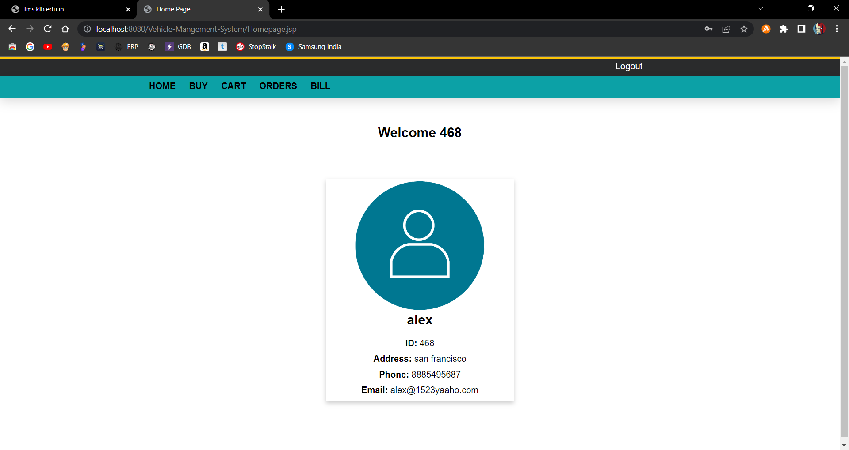
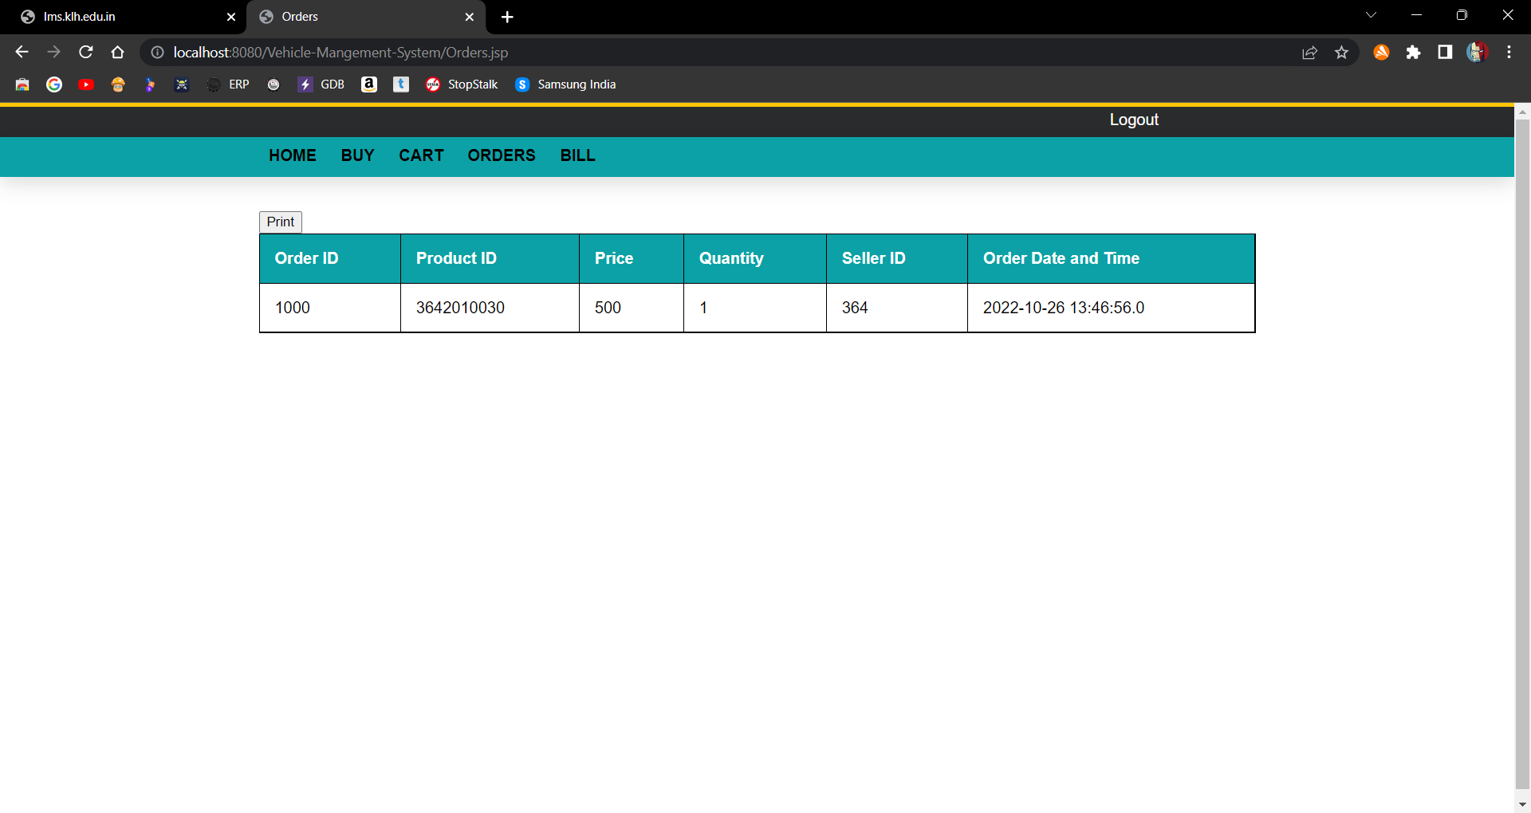
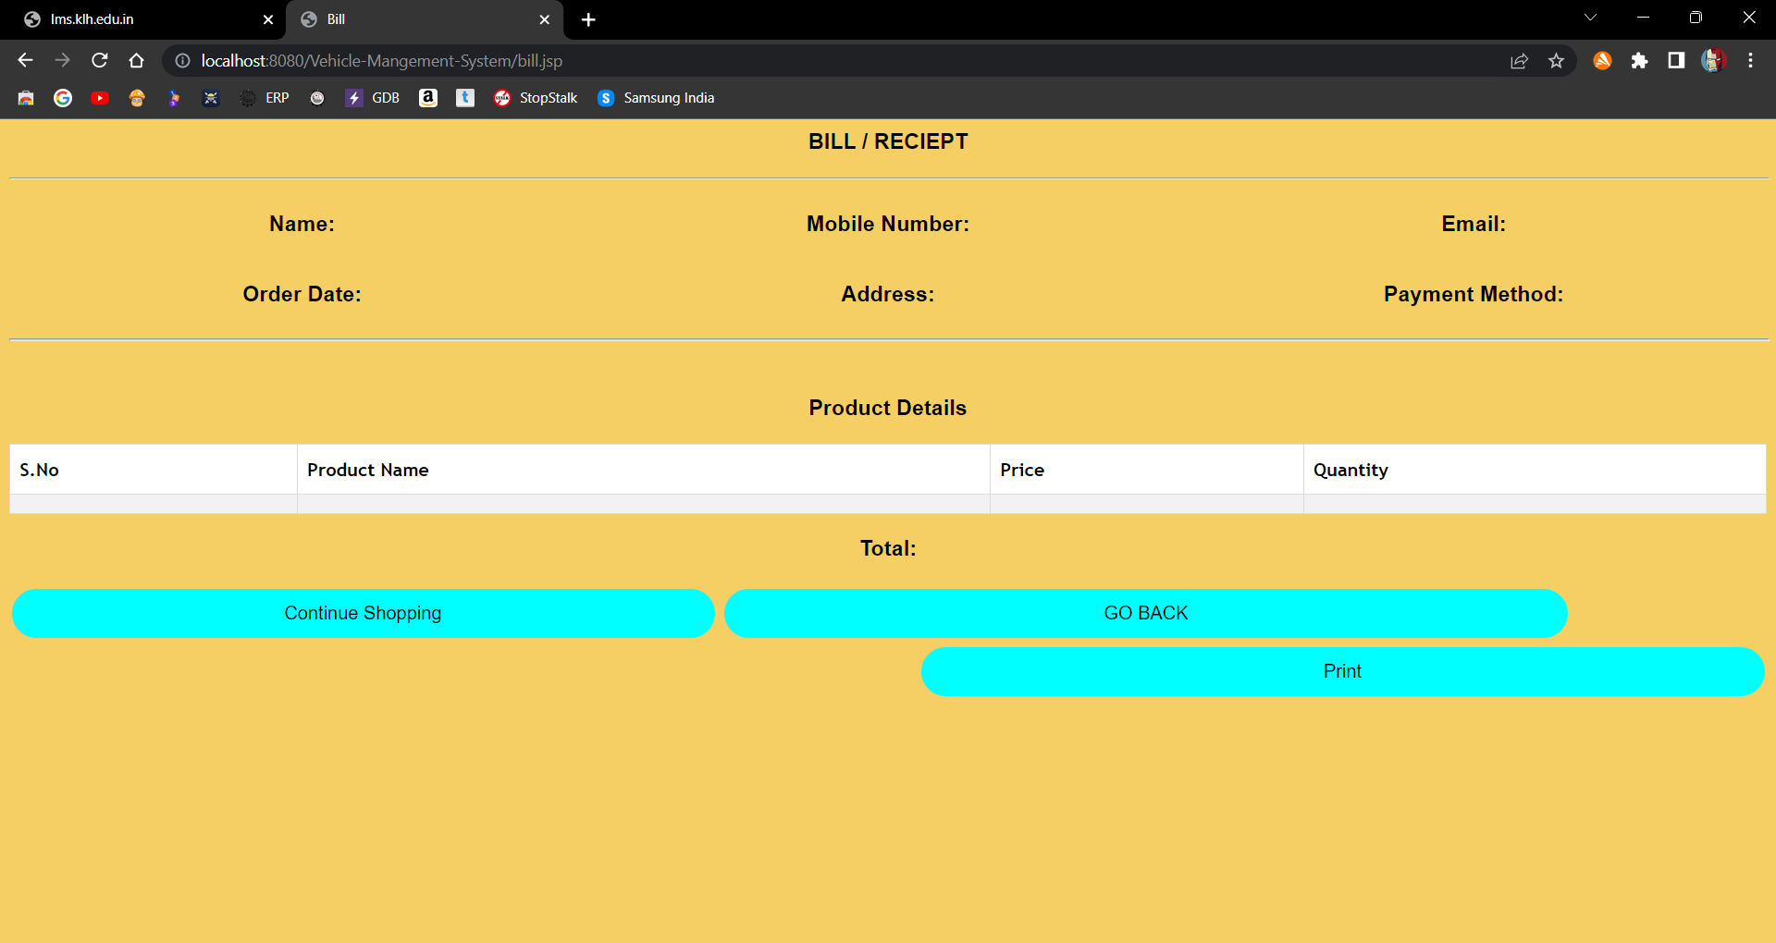
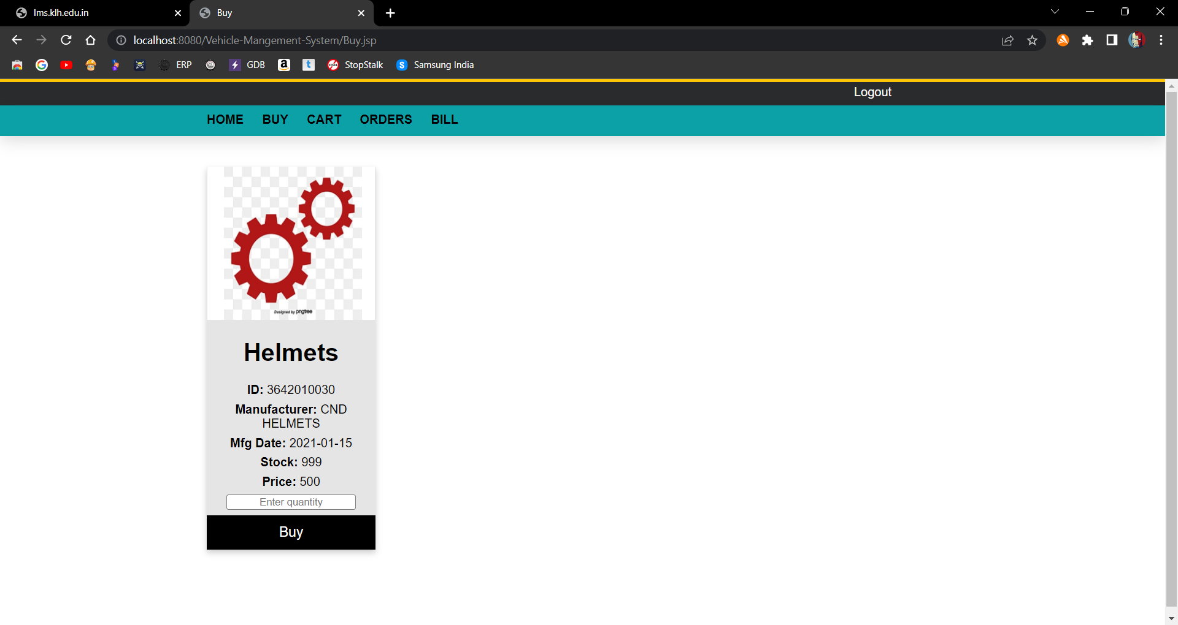
CUSTOMER

Slide 12
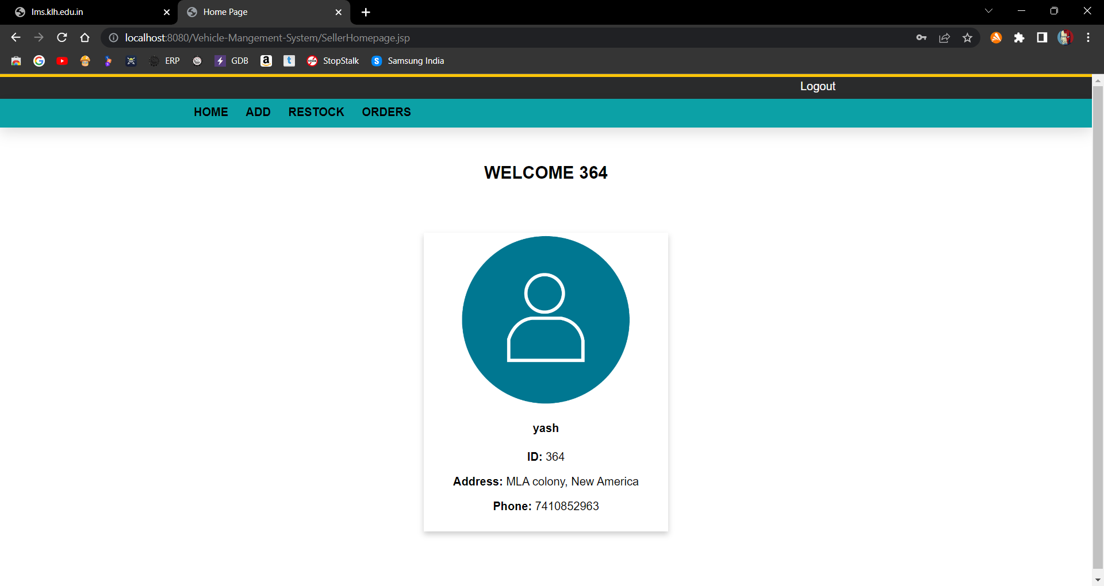
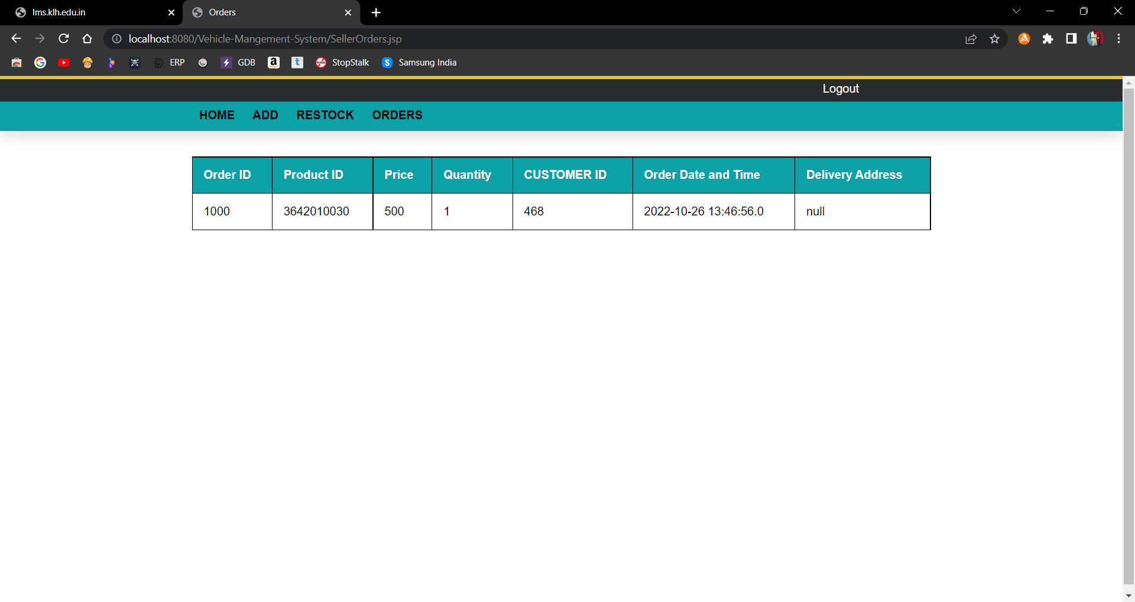
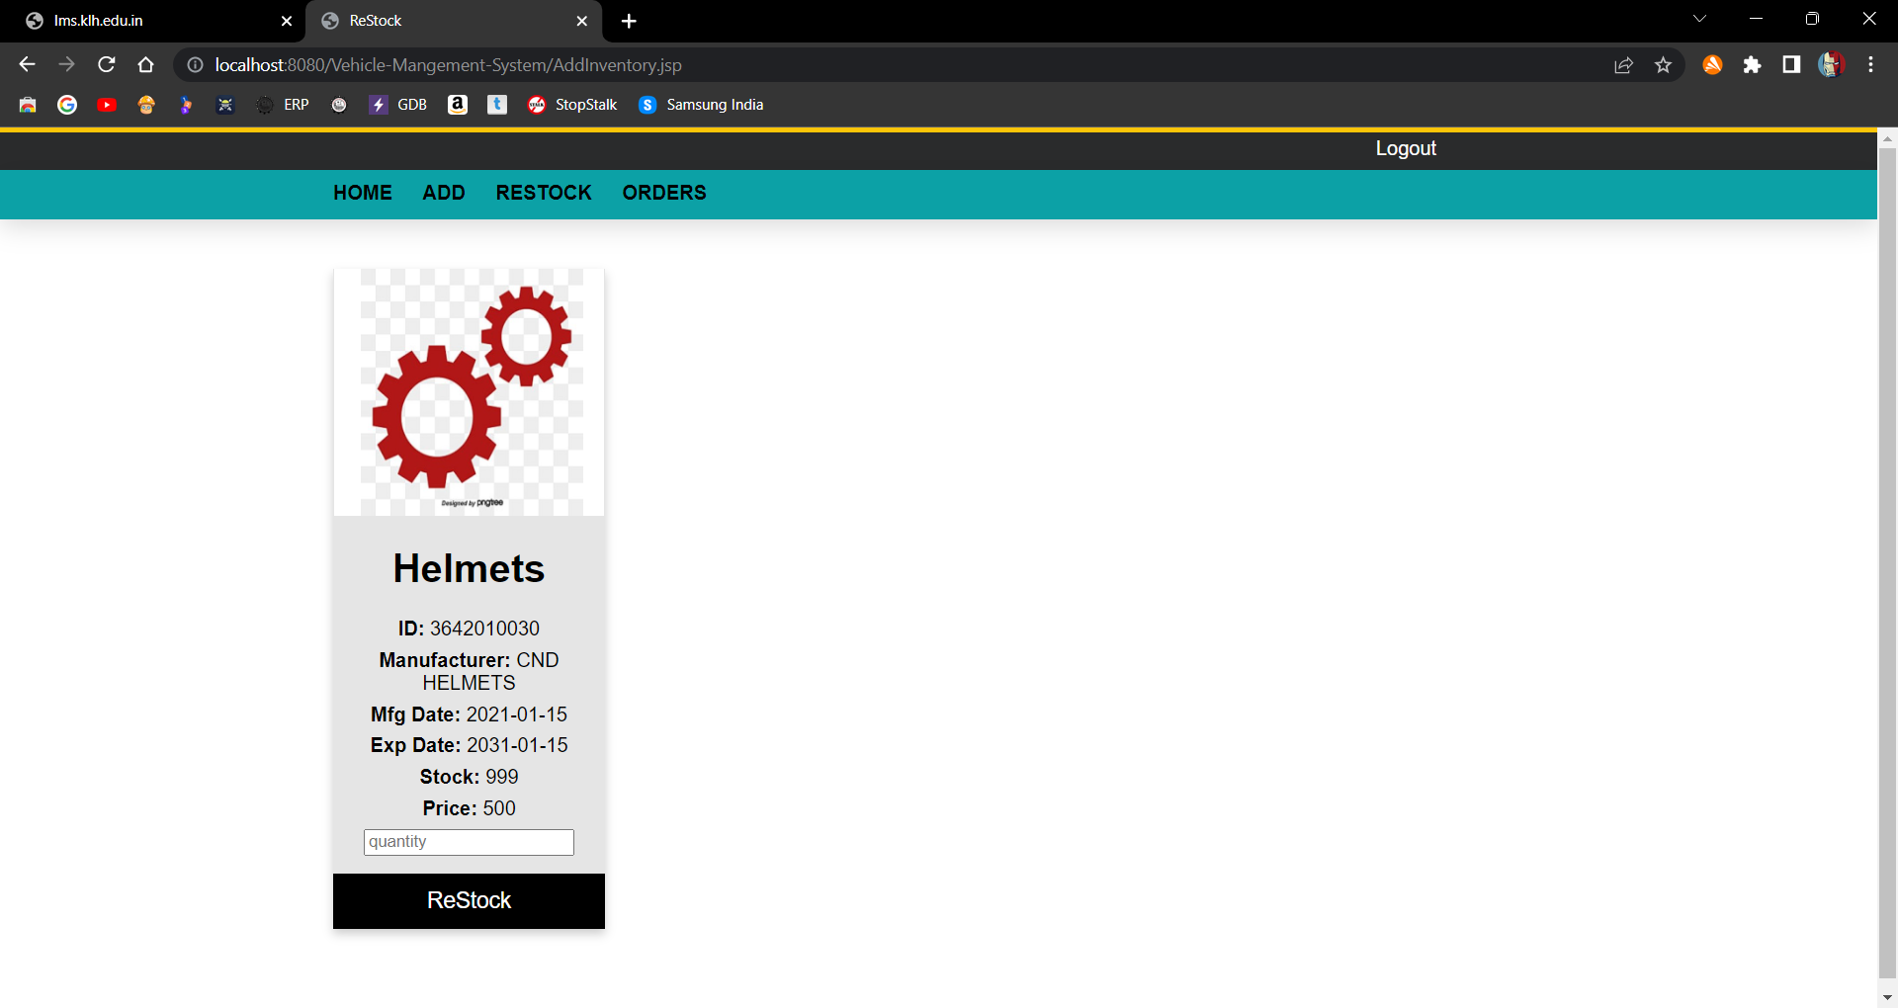
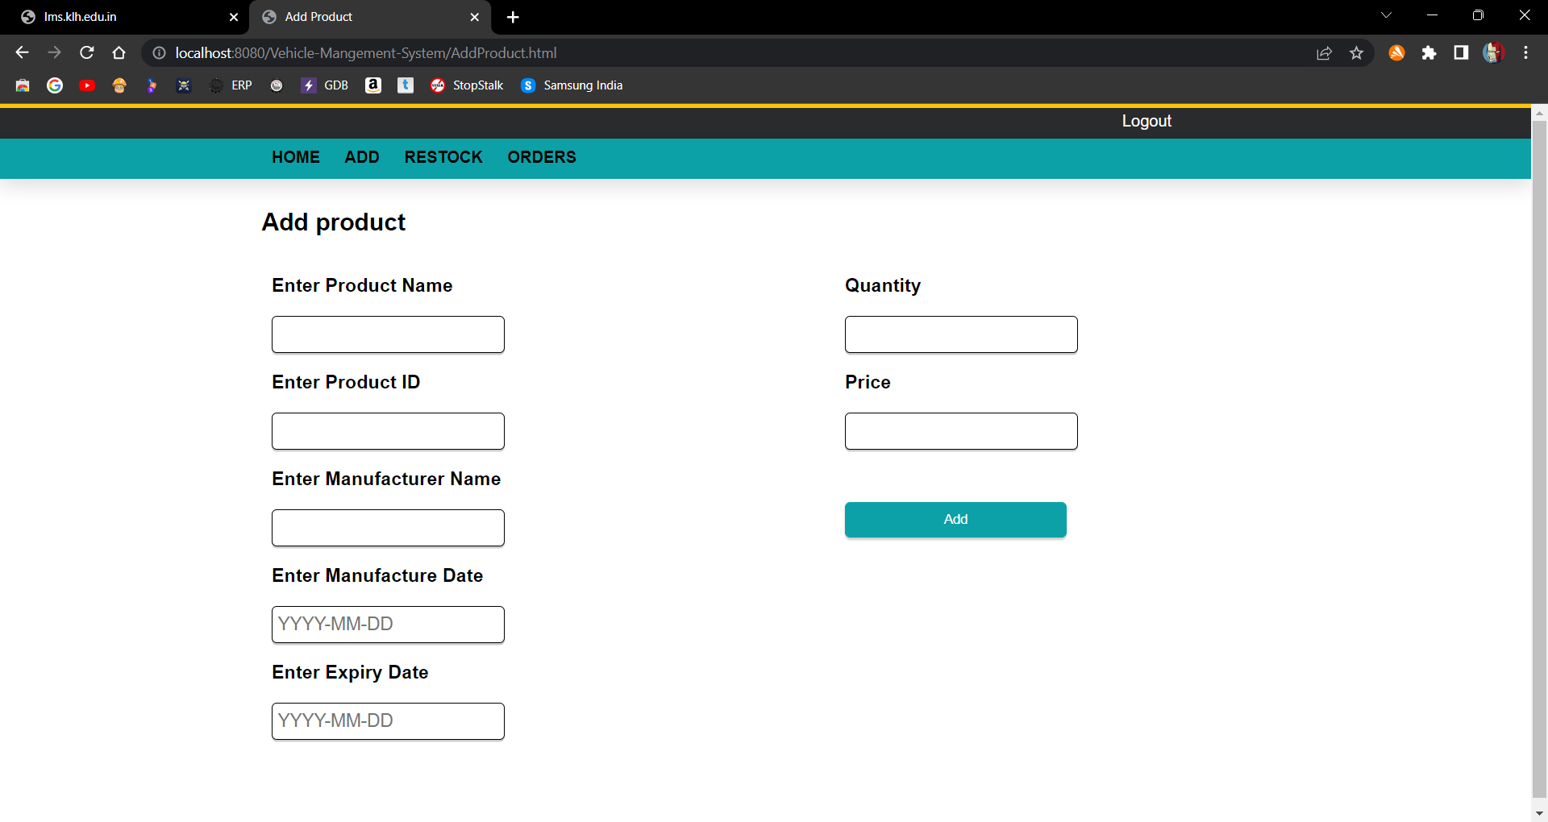
SELLER

Slide 13
CONCLUSION
Consumer Relationship management is a business strategy that enables a business organization to maximize revenue, customer satisfaction, profitability through strategic mobilization, organization, and management of customer’s interests and desires.

Slide 14
THANK YOU

